Slide 1
Situated Agent-Based Simulations at a Large Scale: Load-Balancing
Guided by
Dr.K.Thirupathi Rao
Batch Number-245
Members
Bhargavi.Chilakala(180030705)
G.Divya Sharon(180030928)

Slide 2
ABSTRACT
In huge scale agent-based simulations, memory and computational power supplies can rise intensely because of high numbers of agents and communications.
To be able to simulate millions of agents, allocating the simulator on a computer network is promising, but raises some queries like: agents allocation and load-balancing between machines.
So, we have explored an algorithm for load balancing using agents to distribute load effectively.

Slide 3
Load Balancing
Cloud load balancing is the process of distributing workloads and computing resources in a cloud computing environment.
Load balancing allows enterprises to manage application or workload demands by allocating resources among multiple computers, networks or servers.
It is a method to keep the communication loads balanced between all computational units.

Slide 4
There are two main distribution approaches to simulate largescale situated-MAS applications:
1) agents distribution
2) environment distribution

Slide 5
Environment Distribution
In some applications, the focus can be more on the environment itself instead of agents.
In this case, the environment can be divided between different machines, each machine holds a small part of the environment with agents that exist on this part.
Thus, each machine computes agents perceptions and all interactions that happens within its environment slice.
In other words, each machine manages a part of the environment

Slide 6
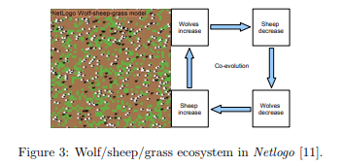
Prey-Predator Model

Slide 7
Agents Distribution
An agent in multi-agent systems (MAS) is an atomic unit, which can not be divided into smaller parts
Agents are the main components on MAS simulations.
Each machine handles N agents to execute their interactions and communicates with other machines to achieve agents’ goals.
That must be done with lowest communication costs. In our platform, each machine has its agents (local agents) and should be able to have information about other agents from other machines which can be called Ghost Agents to allow local agents from interacting normally during the simulation

Slide 8
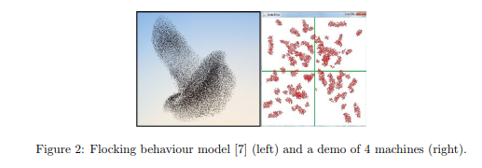
Flocking Behaviour Model

Slide 9
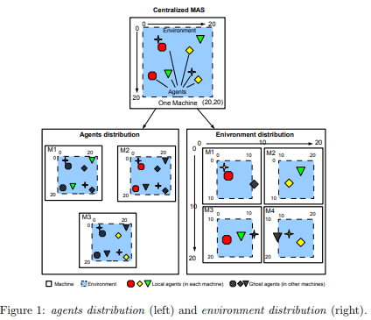

Slide 10
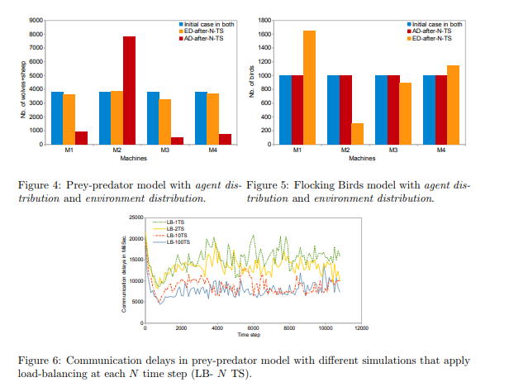

Slide 11
Dynamic Agent-Based Algorithm
An Agent is initialised randomly in one of the servers present in the cloud computing environment. In each cycle, an agent completes two walks.
They are:
First Walk - Identifying the total number of jobs present in the job queues in each server and calculating the average load required.
Second Walk - Transferring load from overloaded to underloaded servers in an efficient way.

Slide 12
FIRST PHASE
Step-1: If S is considered the environment with ‘n’ servers i.e S={S1,S2,S3….Sn} and each server has J={J1,J2,J3….Jn} number of jobs, the agent traverses all the servers and finds the total number of jobs present.Next, an AVERAGE value is computed.
Step-2: In the second iteration, the agent classifies each server as “underloaded”, “overloaded” or “balanced” by comparing the number of jobs in each server with the AVERAGE.For example, if the jobs are more than the average, then it is classified as “overloaded” and so on.

Slide 13
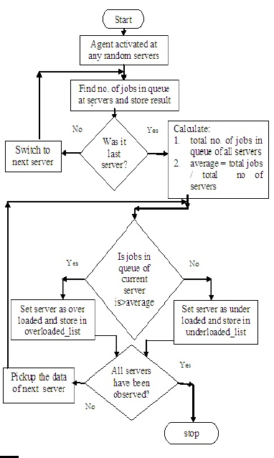

Slide 14
SECOND PHASE
In this phase, the agent traverses each server and check if it is “overloaded”, “underloaded” or “balanced”.
If “Overloaded” : jobs are migrated to underloaded servers.
If “Underloaded” : jobs are added to it until the average is met.
If “Balanced” : No action necessary.

Slide 15
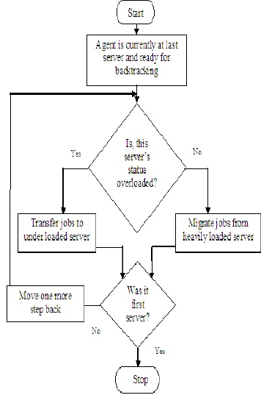

Slide 16
Implementation
The entire scenario has been implemented via Python code.
For simplicity 5 servers have been considered and a random number of jobs have been allocated to each server using “random” package in python.
Once again an agent is invoked randomly in one of these servers and its finds the total jobs present in order to calculate average load in each server.
In the second phase the load is distributed by maintaining a variable (“Extra_jobs”) and re-distributed till all servers are balanced.

Slide 17
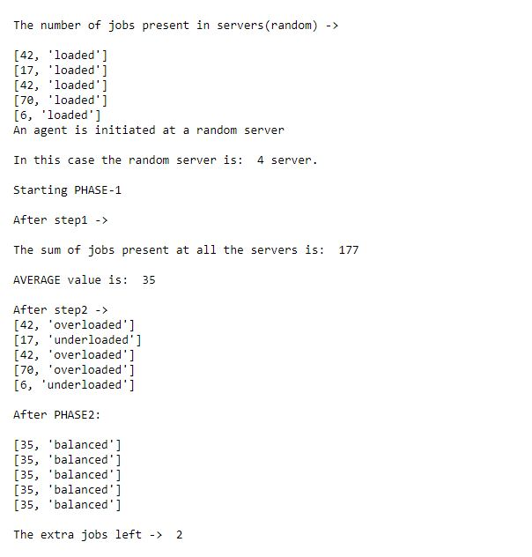

Slide 18
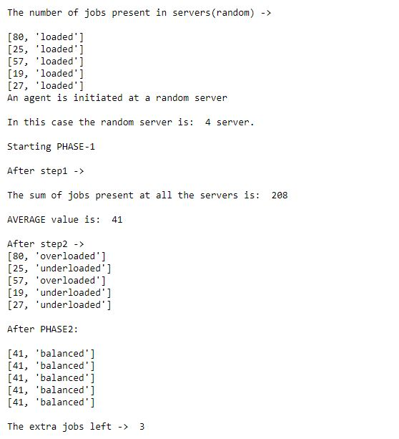

Slide 19
Drawback
Drawback of this algorithm is that , it can balance loads efficiently among the servers when the total number of jobs is a multiple of ‘n’ (total number of servers)
In cases where the number of jobs are not a multiple, some jobs are left unbalanced until next iteration.

Slide 20
References
Books Referred:
Name of the author: Ka-Po Chow and Yu-Kwong Kwok
Title of the paper: On Load Balancing for Distributed Multiagent
Computing
Name of the author: Omar Rihawi, Yann Secq, and Philippe Mathie
Title of the paper: Load-Balancing for Large Scale
Situated Agent-Based Simulations
Name of the author: Xiaohui Cui and Thomas E. Potok
Title of the paper:A Distributed Flocking Approach for Information Stream Clustering Analysis

Slide 21


